Slide 1
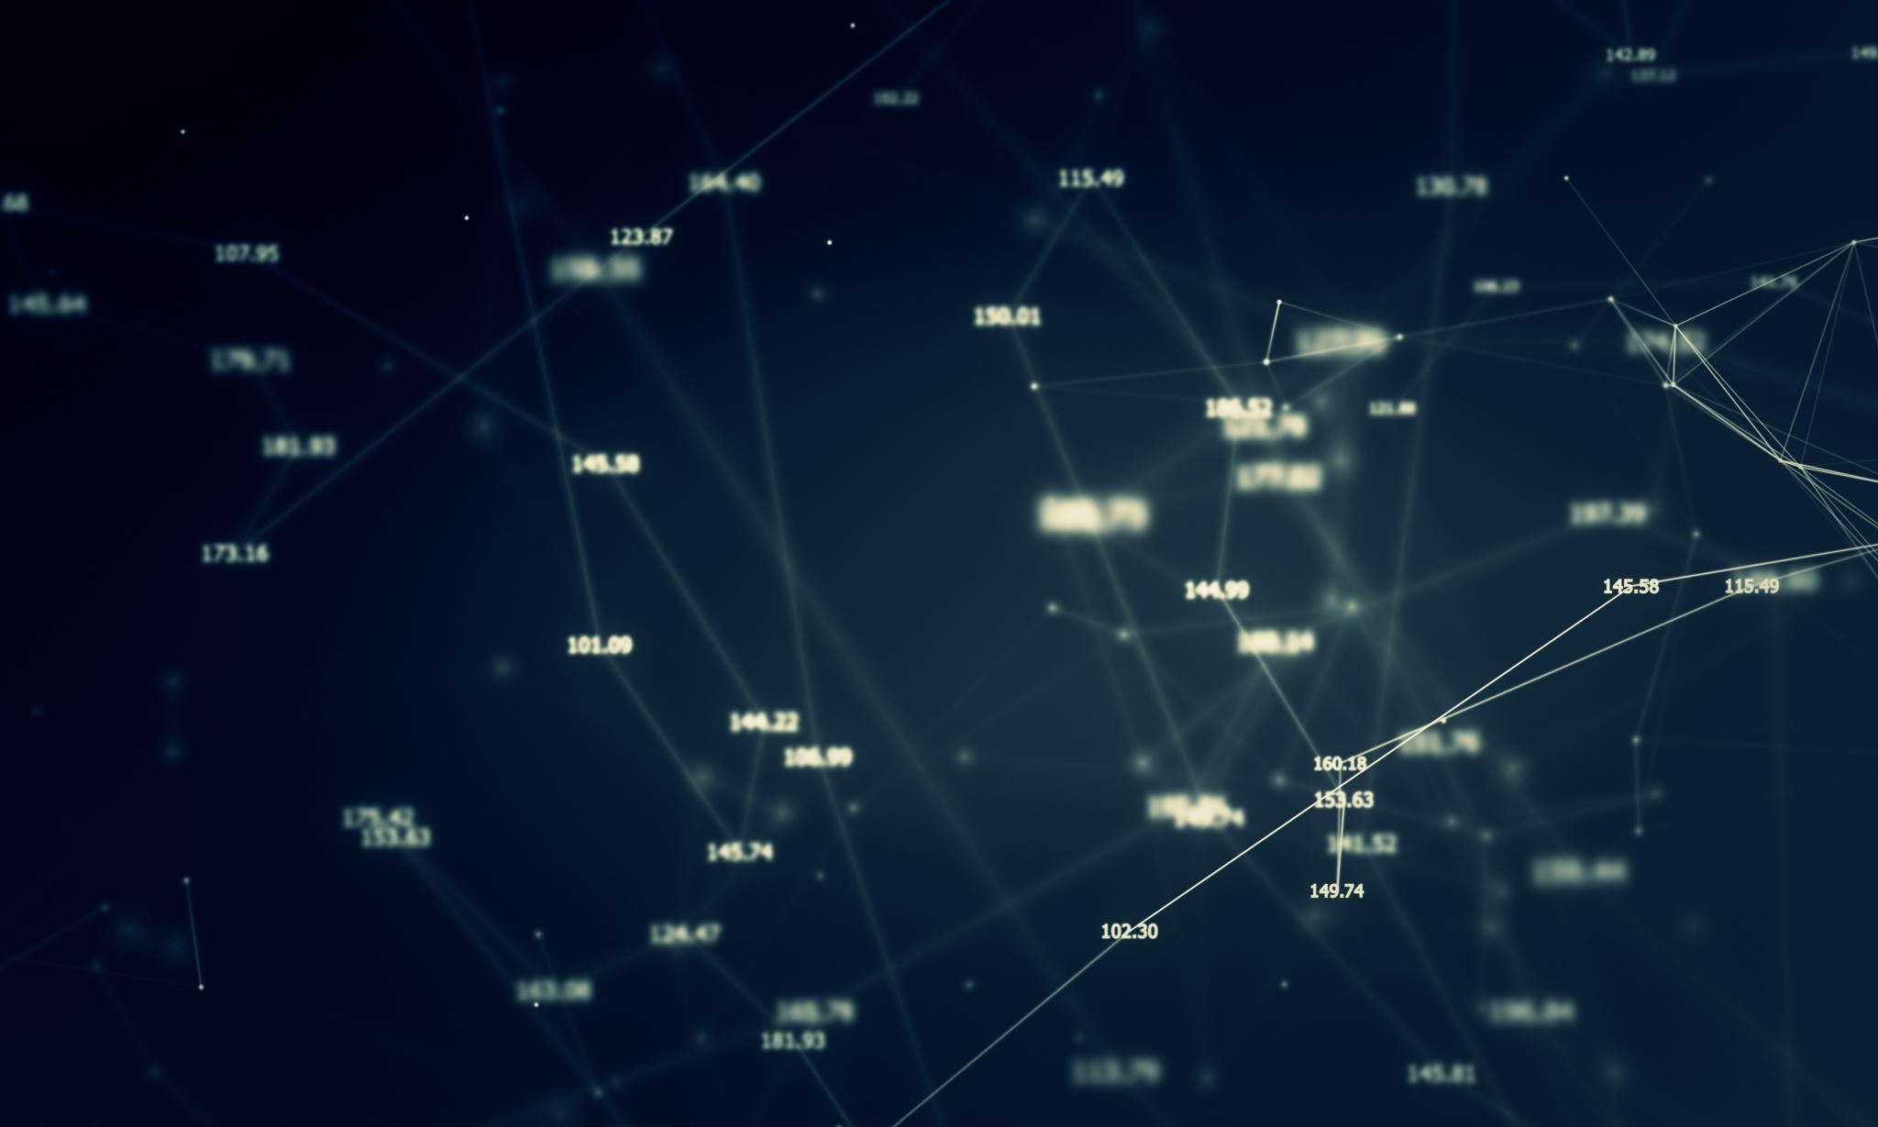
COMPARING SEQUENCE – BASED NLP NETWORKS WITH GRAPH NEURAL NETWORKS IN SEMANTIC CODE SEARCH
Spyros Garyfallos
W266, MIDS

Slide 2
CodeSearchNet
The primary dataset consists of 2 million (comment, code) pairs from open source libraries in six languages.
The Python corpus consists of 457.461 docstrings/function samples, stratified in 90-5-5%
Token Length Quantiles | Comments | Code
0.50 | 10.0 | 72.0
0.70 | 15.0 | 114.0
0.80 | 20.0 | 155.0
0.90 | 33.0 | 237.0
0.95 | 48.0 | 341.0

Slide 3
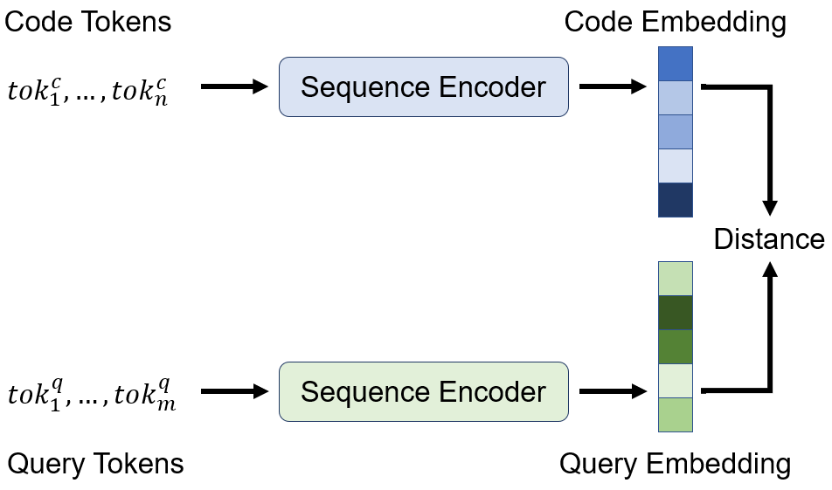
Architecture

Slide 4
BAseline
Neural Bag of Words, where each (sub)token is embedded to a learnable embedding (vector representation).
Bidirectional RNN models, the GRU cell is employed to summarize the input sequence.
1D Convolutional Neural Network, over the input sequence of tokens
Self-Attention, where multi-head attention is used to compute representations of each token in the sequence.
Conv-Self-Attention, a 1D-CNN+Self-Attention Hybrid.

Slide 5
Graph neural networks
Gated Graph Neural Networks, (GGNN)
Relational Graph Convolutional Networks, (RGCN)
Relational Graph Attention Networks, (RGAT) a generalization of Graph Attention Networks to several edge types.
Graph Neural Network with Edge MLPs, (GNN-Edge-MLP) a variant of RGCN in which messages on edges are computed using full MLPs, not just a single layer.
Graph Neural Networks with Feature-wise Linear Modulation, (GNN-FiLM) a new extension of RGCN with FiLM layers

Slide 6
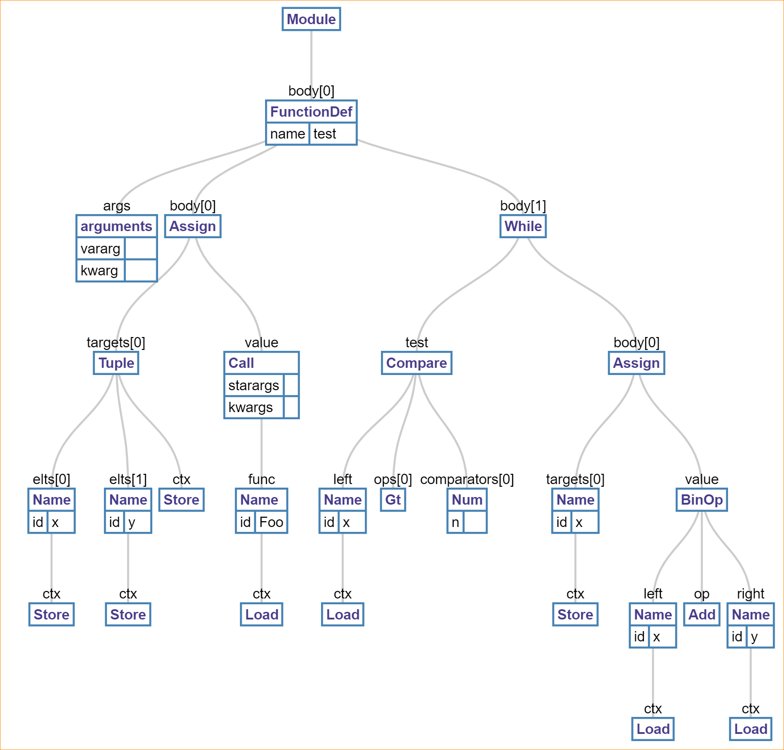
Code2Graph
Start with the abstract syntax tree (AST)

Slide 7
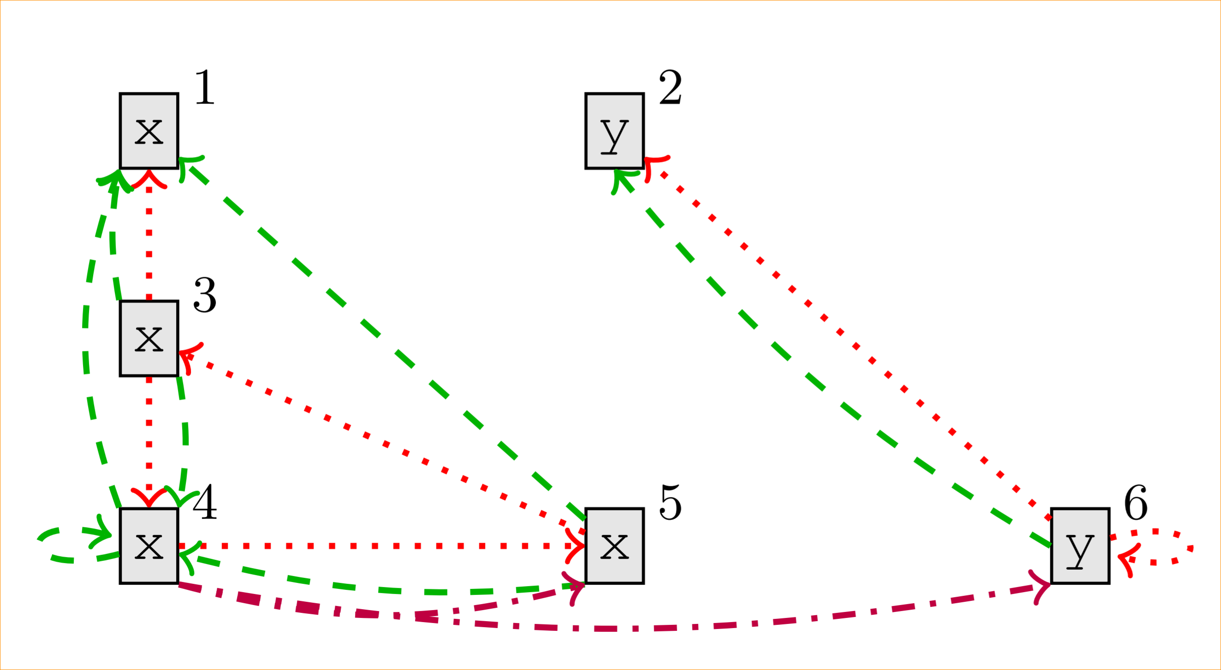
Code2Graph
Augment the AST with semantic

Slide 8
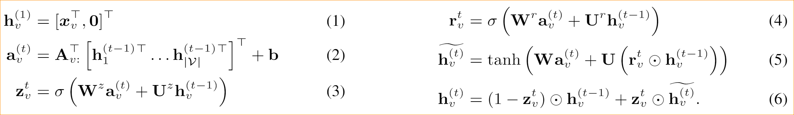
Gated Graph Neural Networks

Slide 9
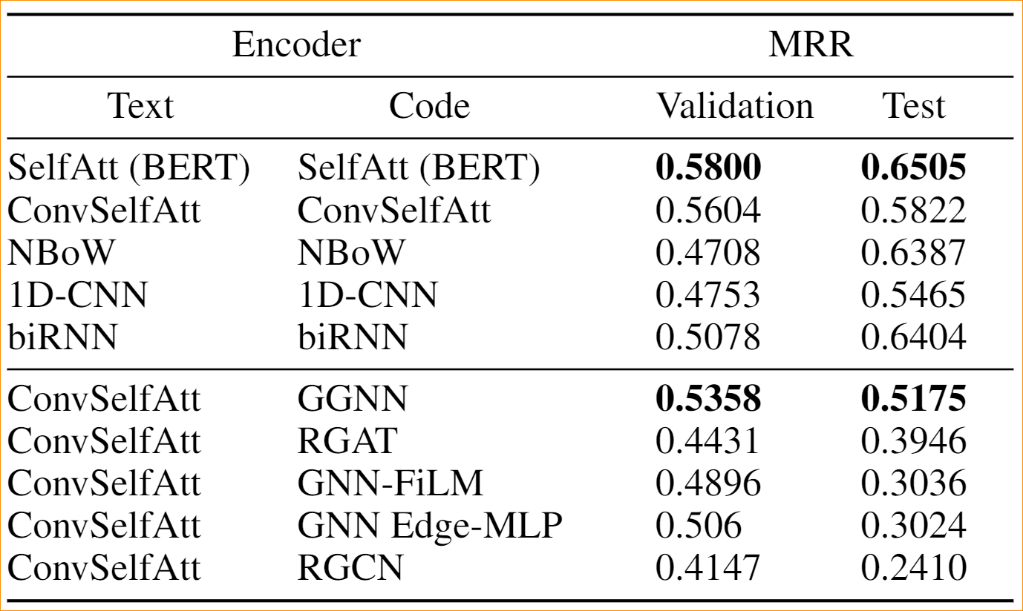
Results

Slide 10
Conclusion
Promising
Difficult data engineering
Faster training than BERT

Slide 11
Possible improvements
Better hyper-parameters tuning. Due to time constraints, not all hyper-parameter combinations where thoroughly explored.
Better data shuffling between the data strata.
A richer semantic graph enhancement, by leveraging more static code analysis heuristics. For example, metadata of the identifiers type could be added to the graph nodes.
Combine the Natural Language information included in the code comments
Standardize the different programming languages keywords into a common vocabulary to achieve language independent graphs. This would enable more complex tasks.

Slide 12
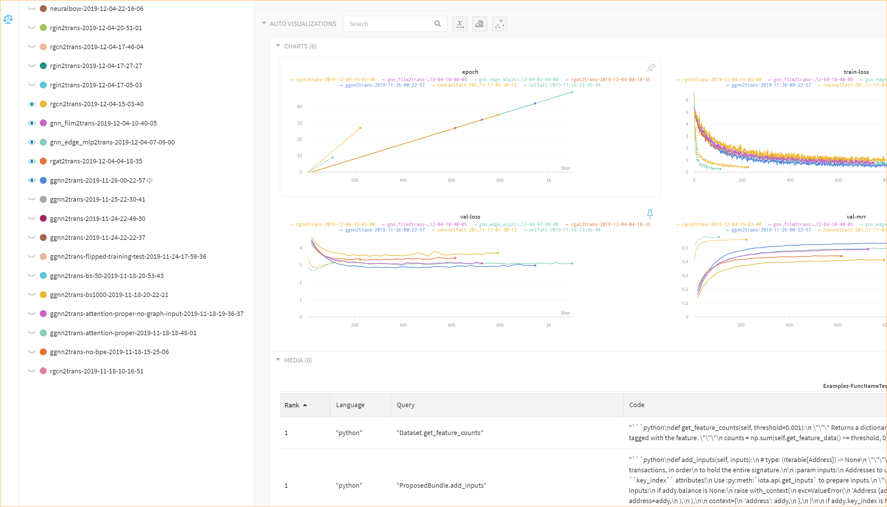
Tooling: WANDB

Slide 13
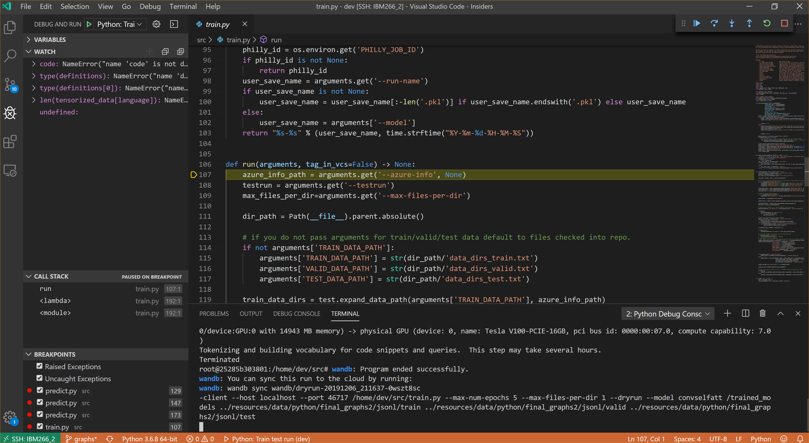
Tooling: VSCODE
Tooling: VSCODE

Slide 14
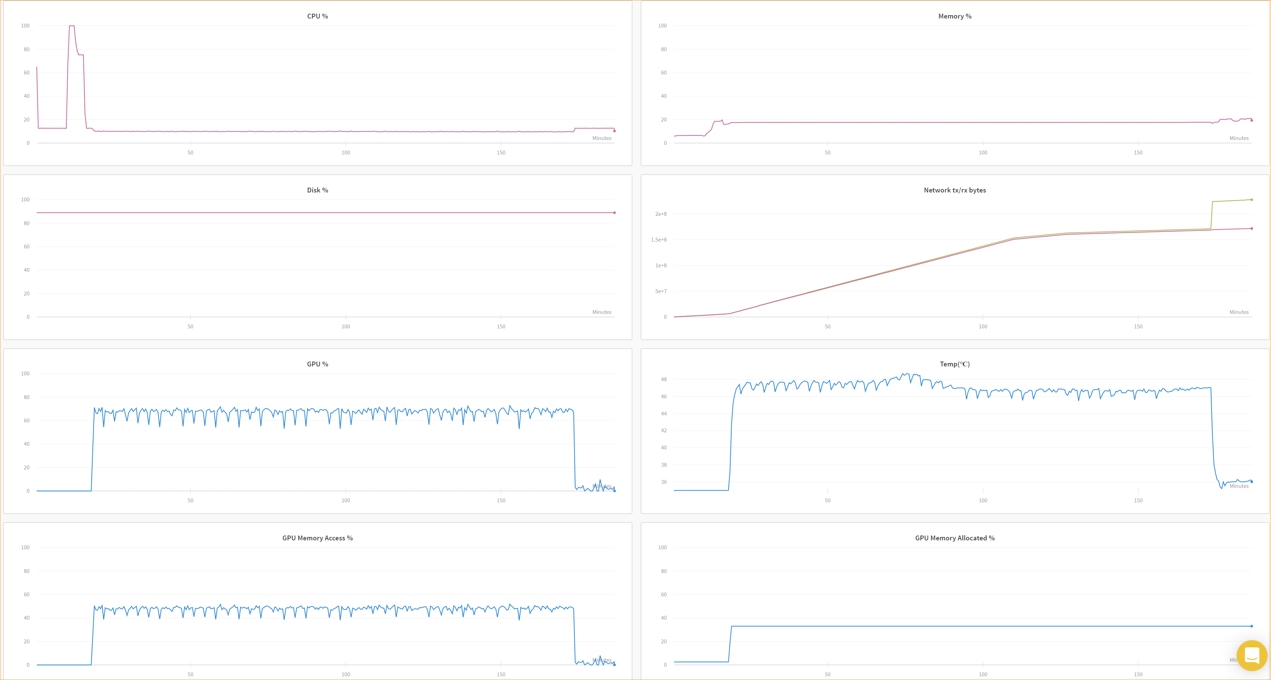
Tooling: cloud v100

Slide 15

Questions?

